Slide 1

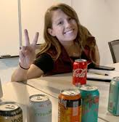
Understanding Iterative Development: The Paper Airplanes Game
Natalie Lukac
Notes:
Natalie Lukac
Scrum Master Ingage Partners
Scrum Master at Kroger Digital – downtown in the Atrium
back end teams developing microservices

Slide 2
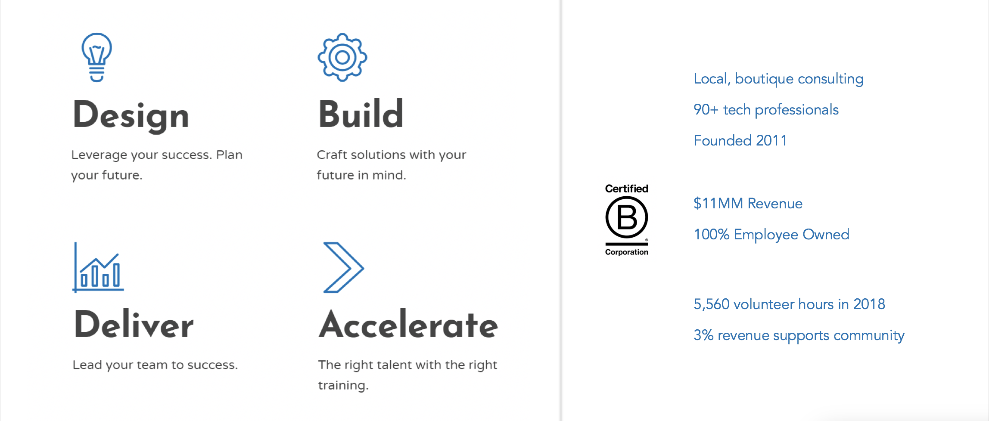
Notes:
I’m here today representing my consulting company – Ingage partners
A little about ingage –
We offer IT software solutions with out design, build, deliver and accelerate plans
a certified b corp and 100% employee owned
Were not only dedicated to our clients but also value our community and the environment,
Through paid volunteer time off, last year ingage donated over 5,000 volunteer hours
If anyone here is interested in learning more, our recruiter SOMEONE is here

Slide 3

Game Volunteers
Team 1
Team 2
Team 3
Minimum of 3 members per team; larger teams preferred
Notes:
10 minutes to eat

Slide 4
Iterative Development
DESIGN
BUILD
TEST
DEPLOY
Notes:
How many people work in iterative development? How many work with scrum? Other frameworks?
we are going to be taking about iterative development but most of this session will focus on scrum.
As most of you know, as an agile framework and agile frameworks use small iterations of work to help teams devliver software fastrer with frequent feedback.
Scrum emphasizes iteration through value of:
working software
collaboration
response to change

Slide 5
Three Pillars of Scrum
Scrum
Transparency
Inspection
Adaptation
em-pir-i-cism /əmˈpirəˌsizəm/ noun (philosophy) The theory that all knowledge is derived from sense-experience. Stimulated by the rise of experimental science, it developed in the 17th and 18th centuries, expounded in particular by John Locke, George Berkeley, and David Hume.
Notes:
Frequent iterations allow teams to learn through experience – the term for this is empiricism – we make decisions based on what is known.
Transparencey – JIRA, trello, rally
Teams Inspecting and adapting the way they work together is essential to scrum abecause it allows teams to make changes that will move them faster in the next sprint

Slide 6



Scrum Framework
Product Owner
Scrum Master
Development Team
The Sprint
Notes:
Scurm framework establishes a consistent way of working. Everyone knows what they are doing and when.
At the ed of the sprint the team takes everything they’ve learned and applies it to the next iteration of work
This is the key to moving faster --- do the work, reflect, and then doing again
Goal of increased efficiently every iteration
create a product that will delighting our customers
Now we are going to put some of these principas in to practice

Slide 7

Welcome to International Paper Airplanes
To be recognized as industry leaders, your team must design, build, and test paper airplanes that meet I.P.A. standards.
Team Goal Build and run successful tests for the most paper airplanes.
Notes:
Those who have volunteered, please come up to the front
At each table is a black folder containing everything you will need

Slide 8


Team Roles
Developer
Scrum Master
Product Owner
Build the planes
Test the planes
Manage the timebox (Kitty Timer)
Clarifying rules
Asking questions
Natalie will clarify any questions

Slide 9
The Timebox
3 minutes
5 minutes
2 minutes
Plan & Estimate
Build & Test
Retrospective
Three Iterations
Notes:
retro - compare how many you built to how many you estimated

Slide 10
The Rules
What is a successful test? The airplane must fly the distance marked by the two blue lines in the test area.
1
Team must estimate number of planes it can build; write estimate on a post-it
3
Each plane may be tested only once
4
Definition of Done: plane must be built and pass testing to count as done
Each developer can make only one fold at a time
2
Notes:
# 3 - successful test is the plan making it all the way down the runway

Slide 11


Let’s Do This!
3 minutes
5 minutes
2 minutes
Plan & Estimate
Build & Test
Retrospective
Three Iterations
Definition of Done: The paper airplane is complete, and has
passed testing within the 5 minute Build & Test timebox.
Notes:
3 iterations - 10 minutes each
Any questions before we start?

Slide 12

International Paper Airplanes Thanks You!
Congratulations,
Industry Leaders!
Notes:
Congratulations – you are all winners!!!!
Lets give a round of applause for all our volunteers

Slide 13
What did you learn?
?
Notes:
Lets discuss, what did you learn??

Slide 14

Thank You!
This activity is based on
“The Paper Plane Game”
created for the
Practitioners Agile Handbook

